Slide 1
Design Patterns
20APC4545 – K.G.A.Manthika

Slide 2
What are design patterns?
Design patterns are like templates for how to solve problems that can be used in many different situations.
They are categorized into three main types,
Creational pattern
Structural pattern
Behavioral pattern

Slide 3
Creational Design Pattern
Creational design patterns solve this problem by controlling the object creation process.
The different types are,
Singleton
Factory Method
Abstract Factory
Builder
Prototype

Slide 4
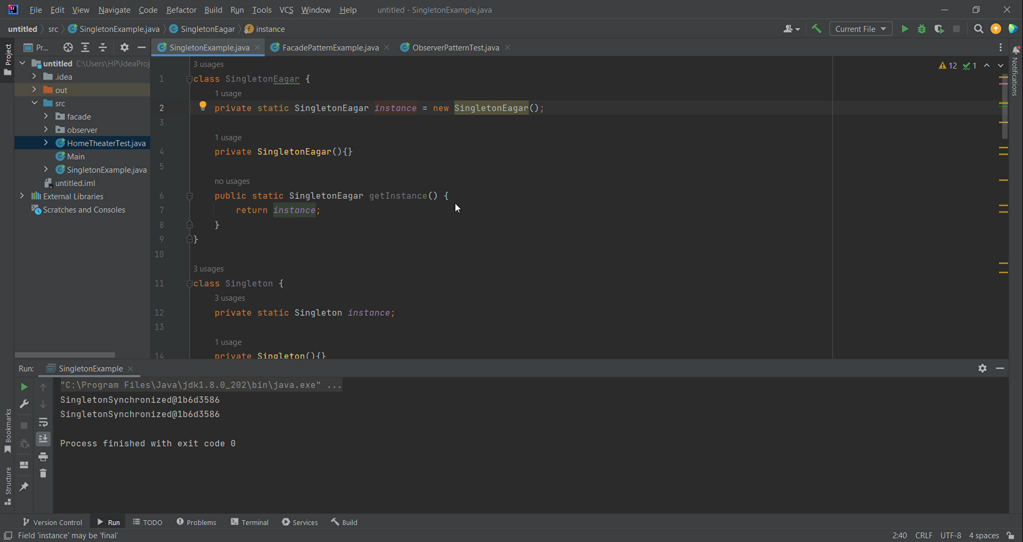
Singleton

Slide 5
Structural Design Pattern
These patterns help to ensure that if one part of a system changes, the entire system doesn’t need to change.
The different types are,
Adapter
Façade
Composite
Decorator
Proxy

Slide 6
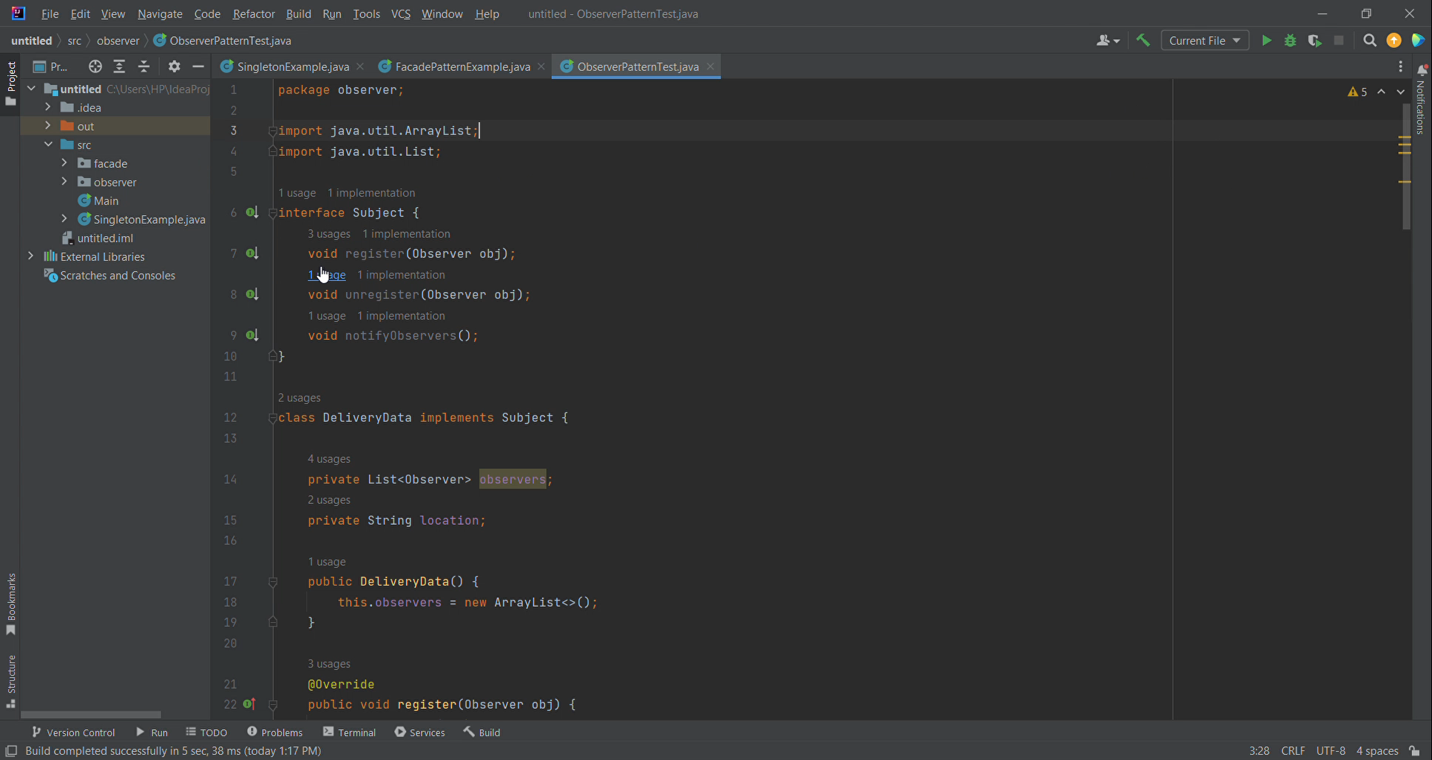
Facade

Slide 7
Behavioral Design Pattern
These patterns deal with object collaboration and responsibility. They help in defining how objects interact and how responsibilities are distributed among them.
Some different types are,
Observer
Iterator
Strategy
Visitor

Slide 8
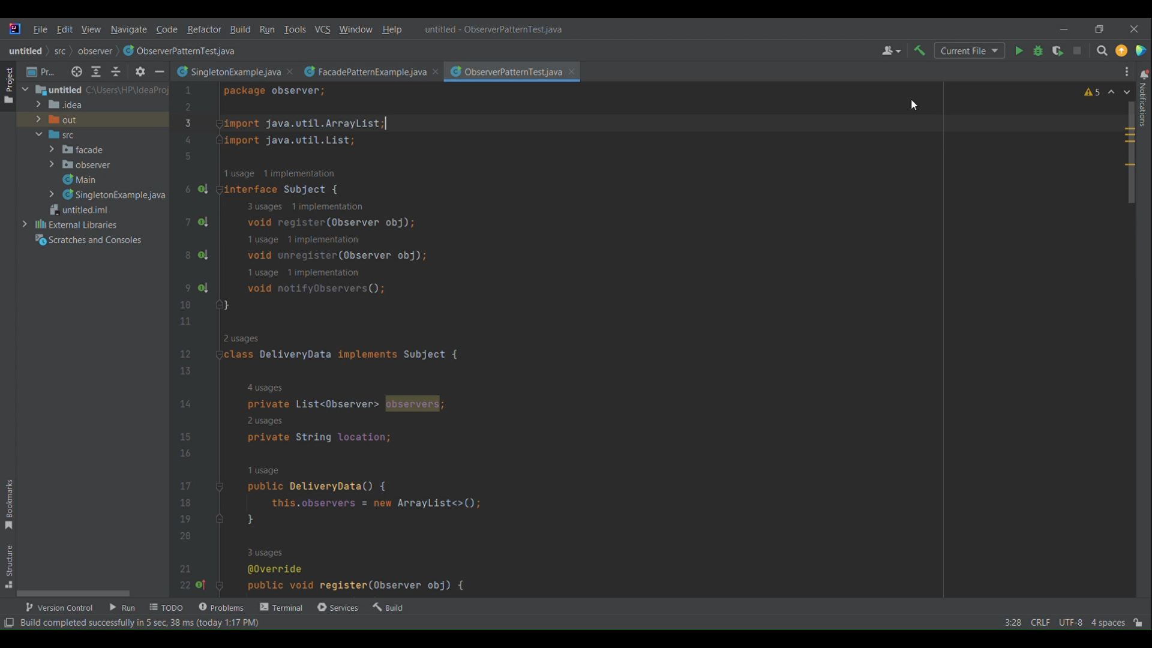
Observer

Slide 9
~Thank You~

